Slide 1
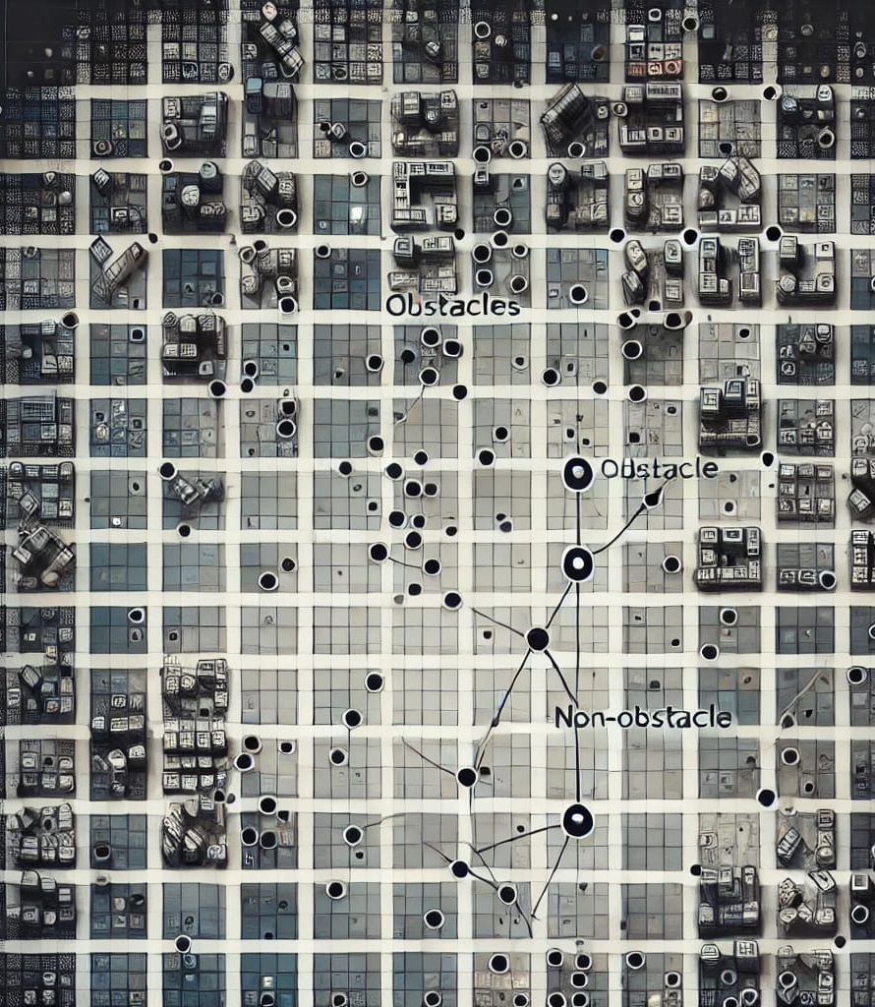
Visibility Learning

Slide 2
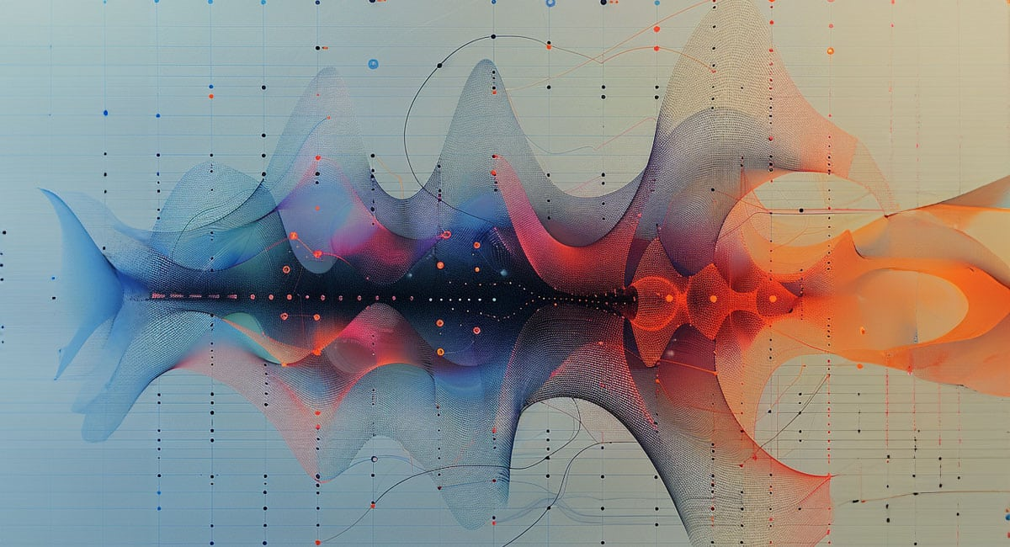
RNN based architecture

Slide 3
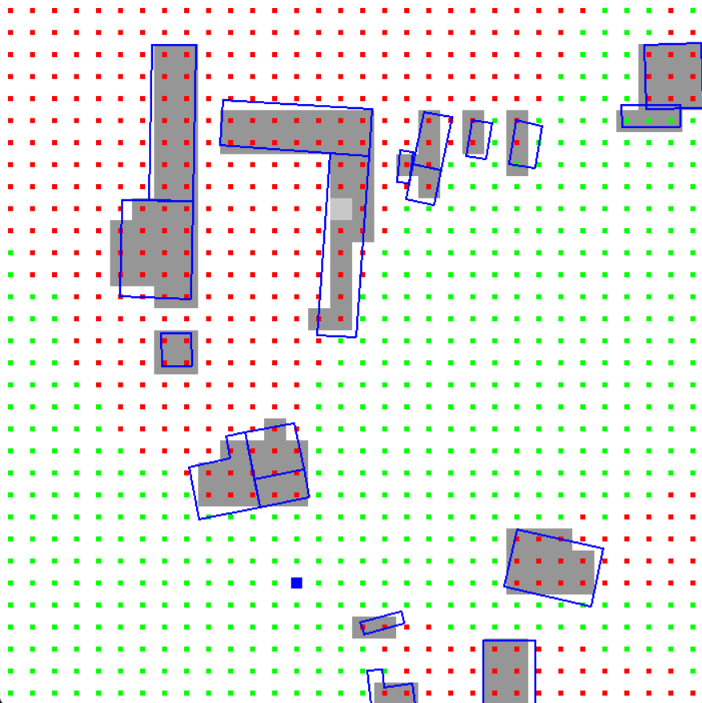
RNN based architecture
Motivation:
In our current implementation, we predict visibility between some fixed cells.
Not between any two continuous points

Slide 4
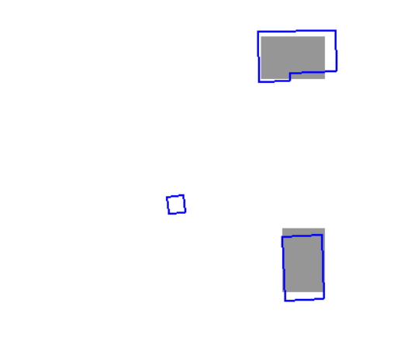
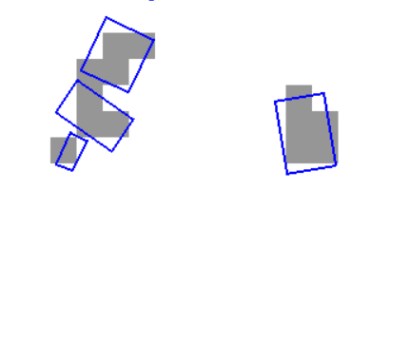
RNN based architecture
Motivation:
Scan conversion loses accuracy
Doesn’t create embedding for obstacles smaller than cell
Incorrectly labels visibility in dataset (in our approach of dataset generation)

Slide 5
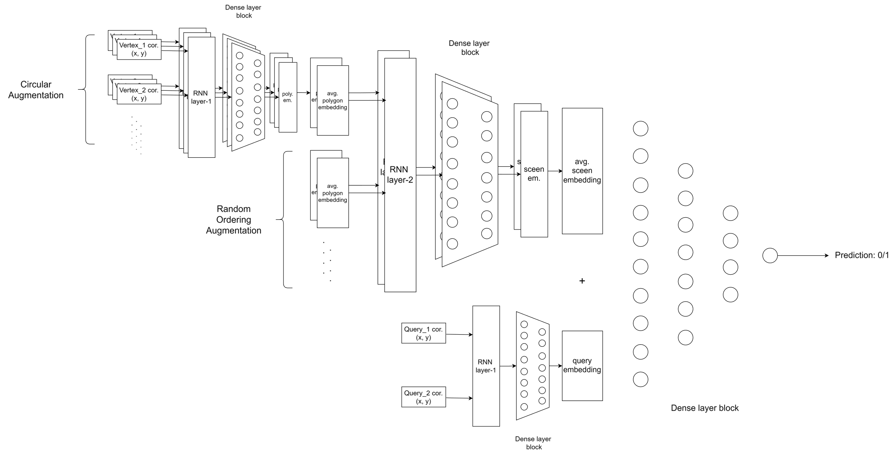
RNN based architecture

Slide 6
RNN based architecture
Testing: 5169 scenes, 500 query points per scene
Training: 3569 scenes, 500 query pairs per scene, 15 epoch | Training: 6169 scenes, 500 query pairs per scene, 6 epoch
Test Loss: 0.3211 Test Accuracy: 0.8556 Test Precision: 0.8968 Test Recall: 0.8437 Test Specificity: 0.8713 Test F1: 0.8694 | Test Loss: 0.3222 Test Accuracy: 0.8563 Test Precision: 0.9138 Test Recall: 0.8257 Test Specificity: 0.8968 Test F1: 0.8675

